Slide 1
Olorin AI
The Palantir for Healthcare
Leading solution for data-driven predictive decision making

Slide 2



The Problem
Staffing in Healthcare
&
Supply Chains in Healthcare
No Real-World Data
Resource consuming
Expensive
Knowledge for process optimizations based on assumptions, not on exact live data and predictions.
Due to poor planning staff (already in short supply) is not deployed in a manner of resources. GER has shortage of 300,000 nurses and 6,300 physicians by 2030.
Suboptimal processes cost money. Healthcare in GER costs about 410 billion per Y (5% CAGR) & hospitals are increasingly facing financial difficulties.
Due to lack of data insights, processes in healthcare are often
non-transparent and therefore resource-consuming and expensive.

Slide 3




Solution
Available
Data (-Streams)
Pattern Recognition & Prediction
Process adaption
Real-World Data
Ressource saving
Cost saving

Slide 4







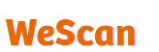
Customer & Market
Starting with 2 different applications
Staffing in Healthcare
Supply Chains in Healthcare
Customer
Hospitals & Service Providers
Shortage & poor distribution of staff
➔Loss of money
Prediction when which staff is needed
Better patient-staff ratio
➔Lower costs
Higher capacity utilization
➔Increase of Revenues
Wholesalers & Medtech/Pharma
Poor distribution of medical products
➔Loss of money
Prediction when which products are needed where
Better distribution of products
➔Increase of Revenues
Problem
Our Service
Outcome
See Case Study

Slide 5
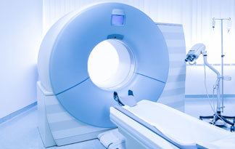
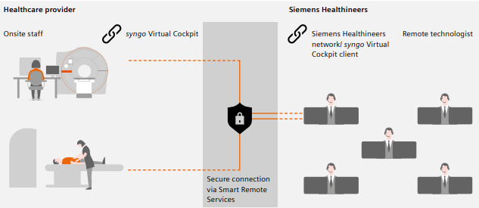
Customer & Market
Case Study
Leverage AI to deploy technicians in a predictive manner and thus use resource wisely to provide more patients (Stroke) with access to MRIs.
Task
KPIs:
Prediction of remote technicians needed
Reduction of remote technicians needed per customers (from 1:4 to 1:6...)
Reducing costs and increasing profit for Siemens Healthineers
Increase in profit for the hospital
Enabling patients to access MRI 24/7 everywhere in GER

Slide 6
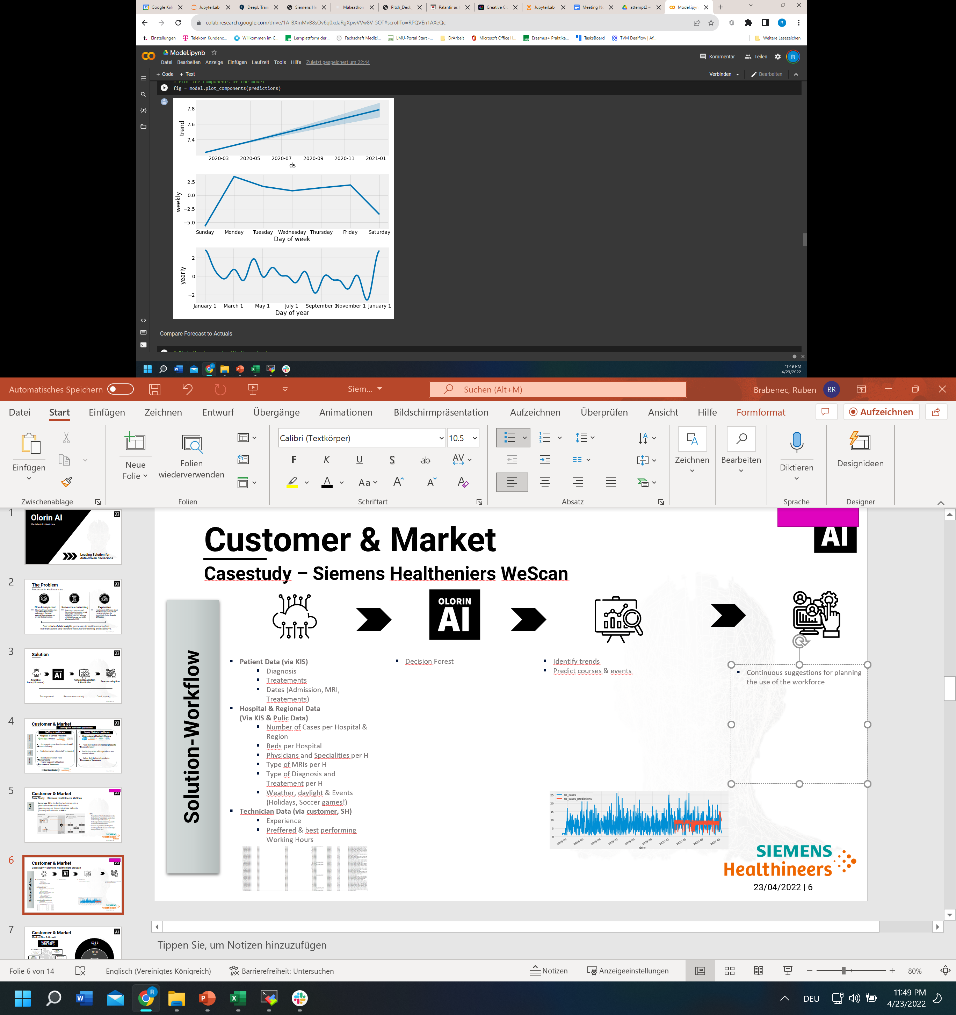

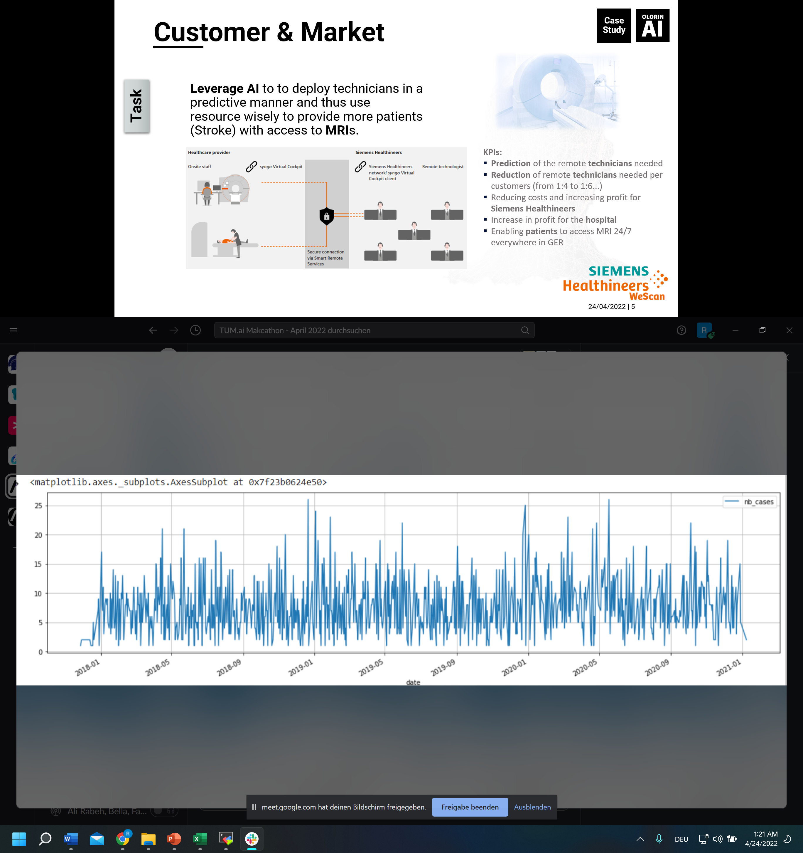
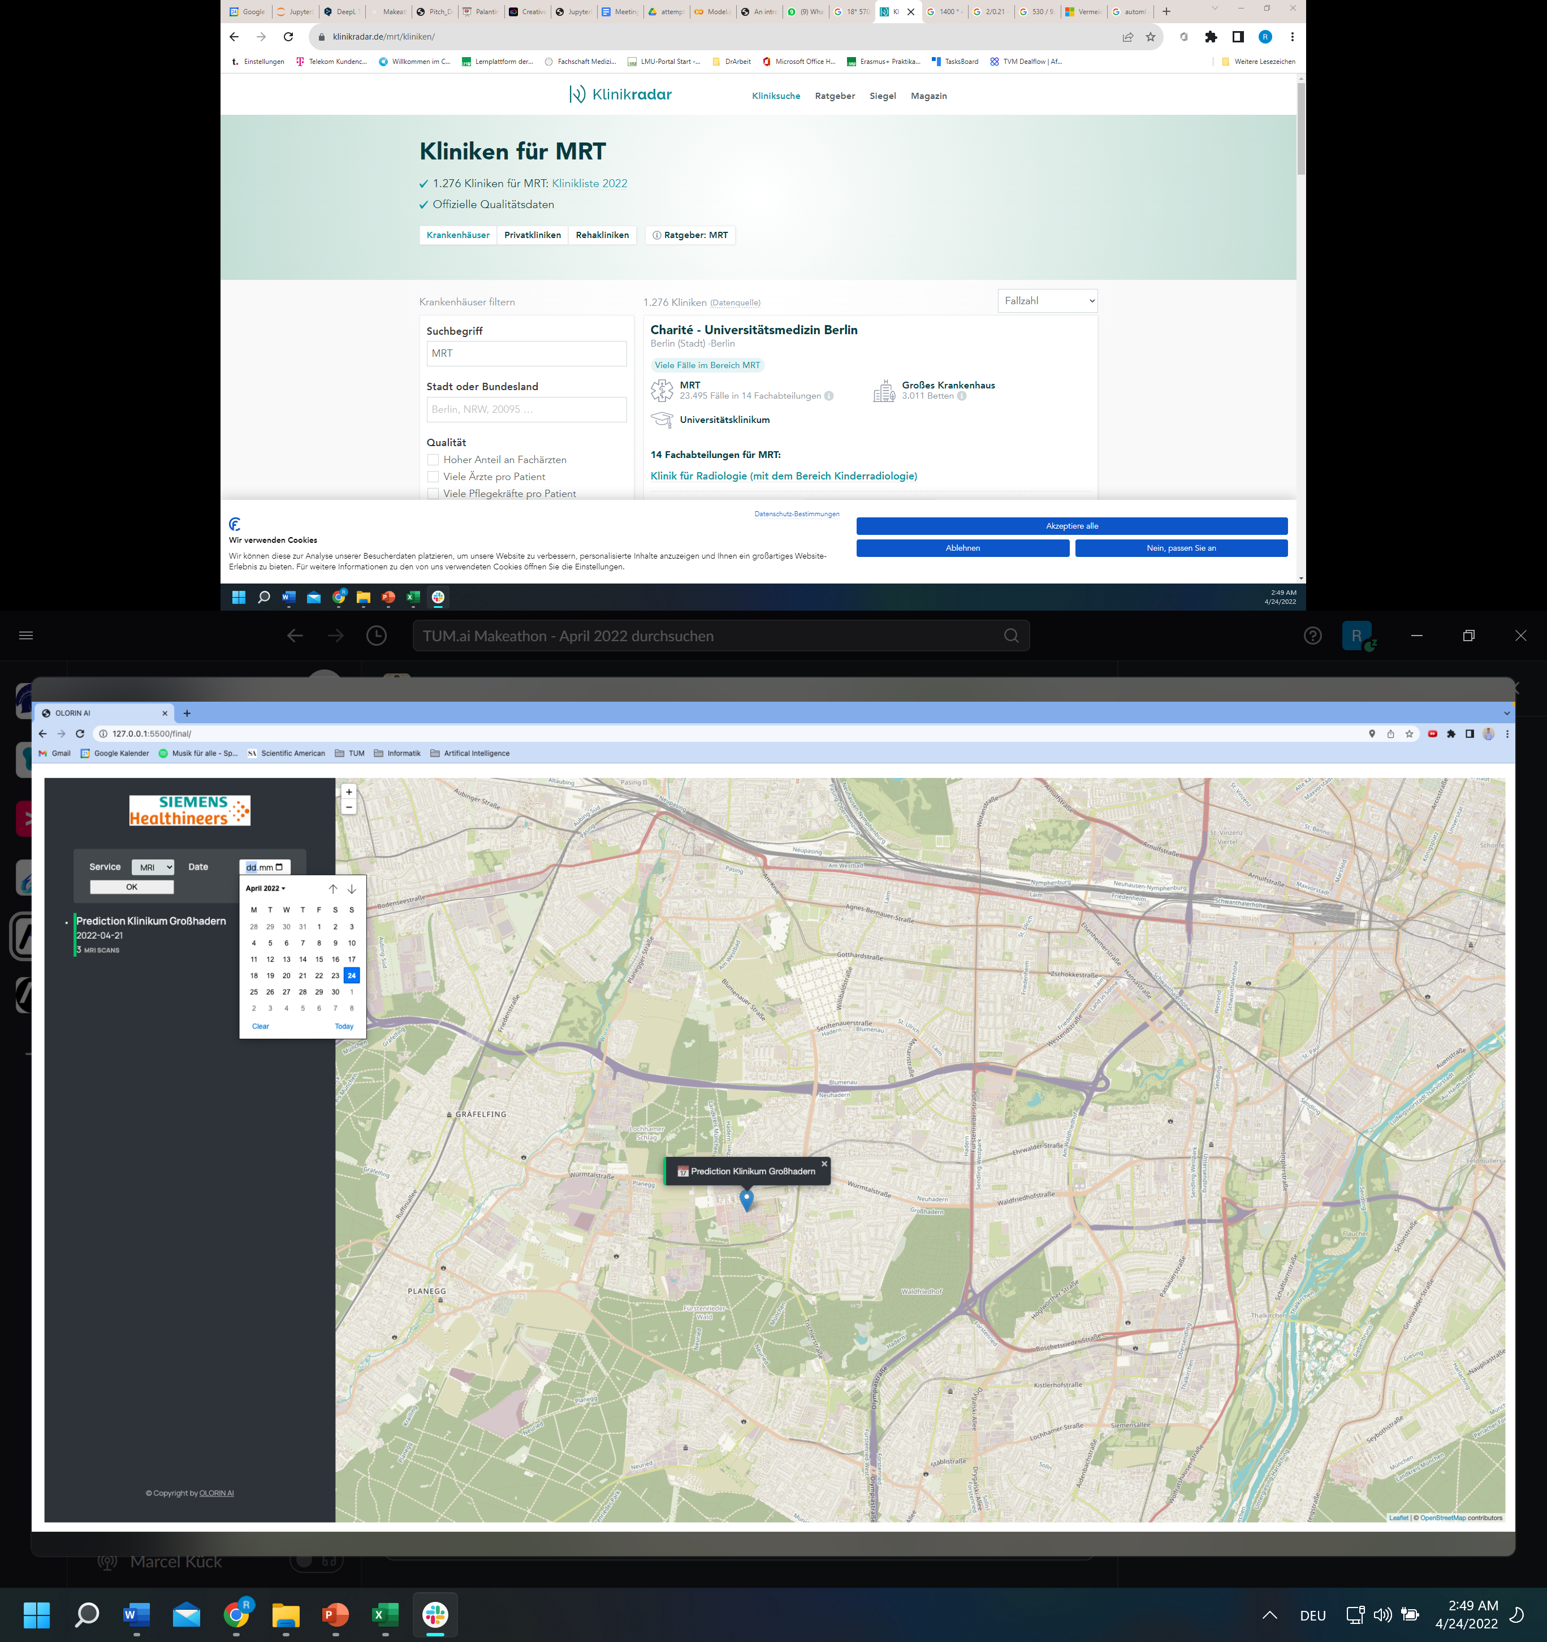
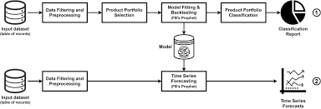
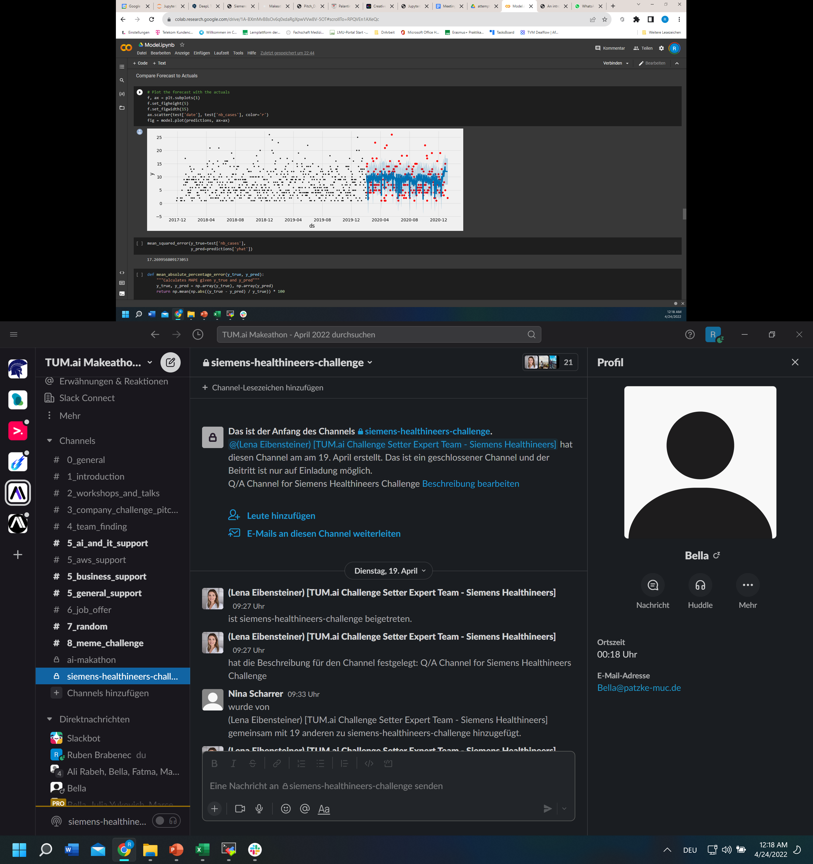
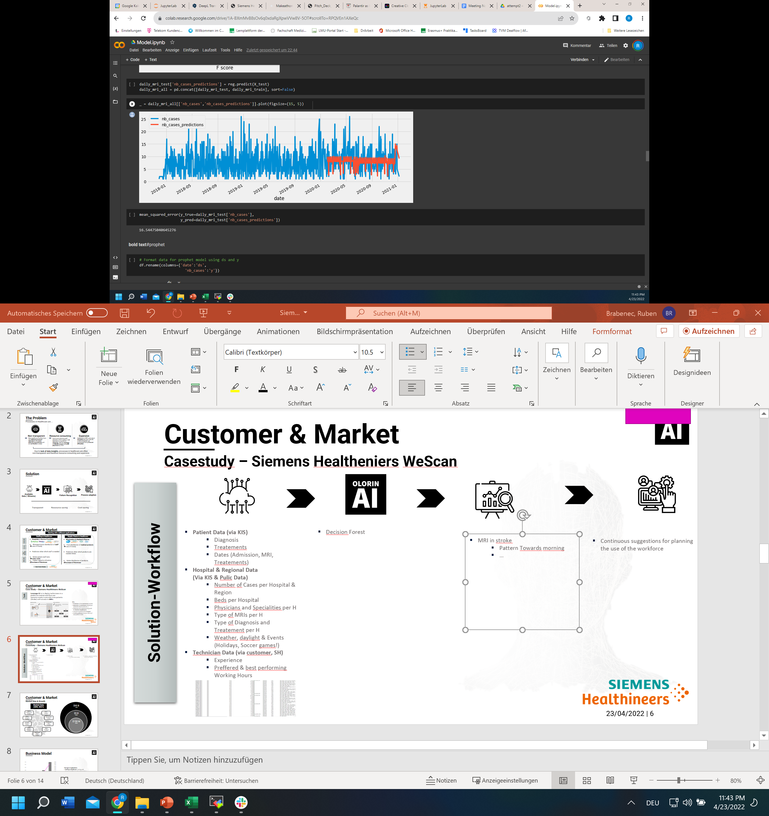
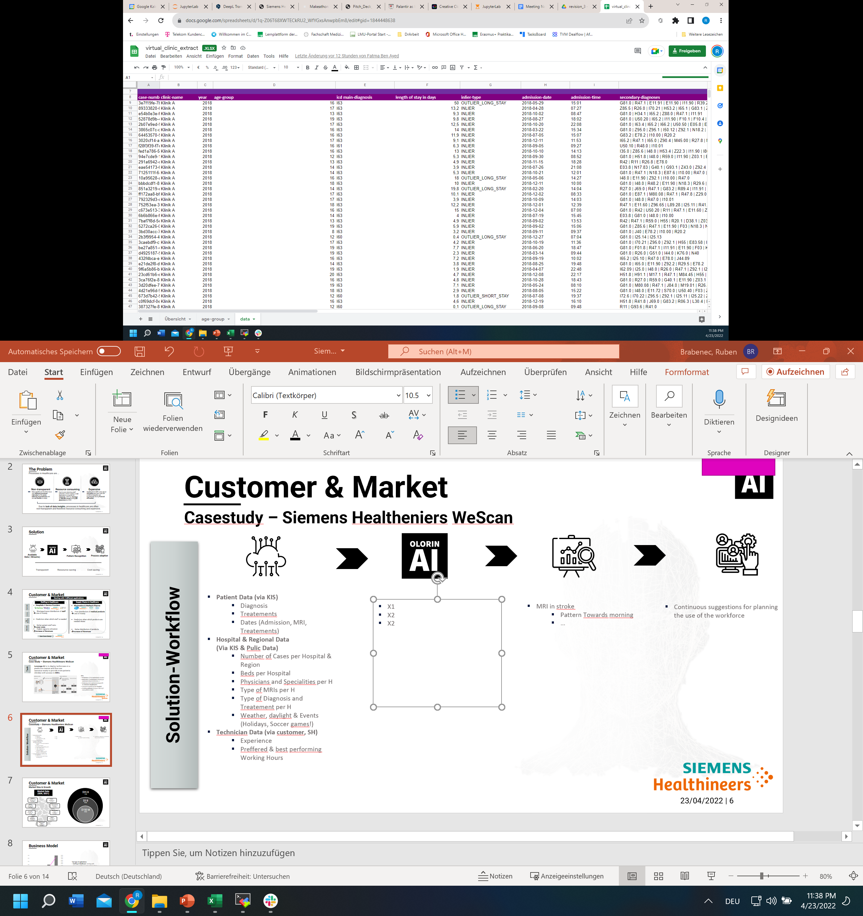
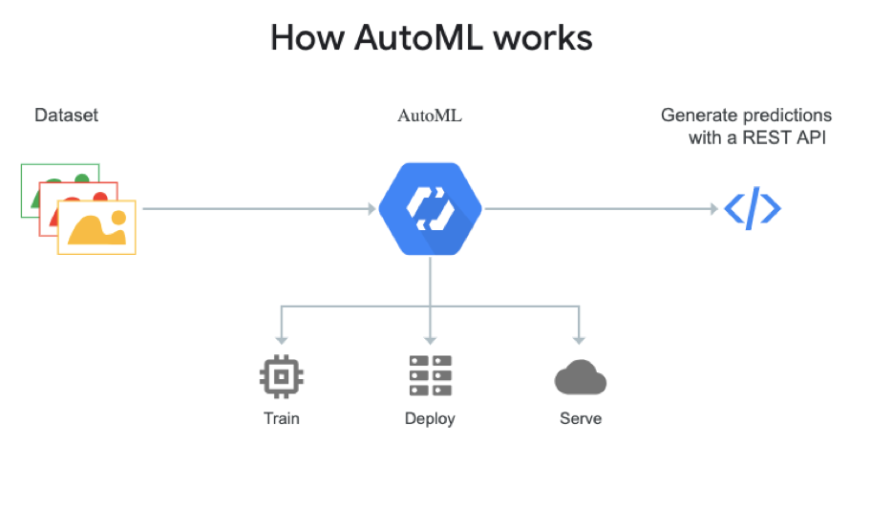
Customer & Market
Case Study
Front end software shows needed staff prediction for desired hospital
Patient Data (via KIS)
Diagnosis
Treatements
Dates (Admission, MRI, Treatements)
Hospital & Regional Data (Via KIS & Pulic Data)
Number of Cases per Hospital & Region
Beds per Hospital
Physicians and Specialities per H
Type of MRIs per H
Type of Diagnosis and Treatement per H
Weather, daylight & Events (Holidays, Soccer games!)
Technician Data (via customer, SH)
Experience
Preffered & best performing Working Hours
3 different approaches
Random Forests Algorythm Supervised MLAlgorithm used for Classification and Regression problems.
Facebook Prophet Algorythm Algorythm for forecasting time series data based on an additive model where non-linear trends are. It is robust to missing data and shifts in the trend, and typically handles outliers well.
Google AutoML Automates the selection, composition and parameterization of ML models.
Identify trends
Continuous suggestions for planning the use of the workforce
1:6 – 1:9.5 workforce planning is possible
Solution-Workflow
Predict courses & events

Slide 7
Customer & Market
Case Study
Front end software shows needed staff prediction for desired hospital
Patient Data (via KIS)
Diagnosis
Treatements
Dates (Admission, MRI, Treatements)
Hospital & Regional Data (Via KIS & Pulic Data)
Number of Cases per Hospital & Region
Beds per Hospital
Physicians and Specialities per H
Type of MRIs per H
Type of Diagnosis and Treatement per H
Weather, daylight & Events (Holidays, Soccer games!)
Technician Data (via customer, SH)
Experience
Preffered & best performing Working Hours
3 different approaches
Random Forests Algorythm Supervised MLAlgorithm used for Classification and Regression problems.
Facebook Prophet Algorythm Algorythm for forecasting time series data based on an additive model where non-linear trends are. It is robust to missing data and shifts in the trend, and typically handles outliers well.
Google AutoML Automates the selection, composition and parameterization of ML models.
Identify trends
Continuous suggestions for planning the use of the workforce
1:6 – 1:9.5 workforce planning is possible
Solution-Workflow
Predict courses & events

Slide 8
Customer & Market
Case Study
Siemens Healthineers WeScan
Market (Hospitals with MRI)
Revenue: 100k per customer per year
5700 on-call hours
18 € per on-call hour
Expense: 200k€ (at 1:4), per one more customer the expenses increases by 40k€ more per technician
Ratio: technician per customers
Current ratio: 1:4
Possible: 1:6 – 1:9.5
Profit:
At 1:4: 50k€ per Customer
At 1:5: 52k€ per Customer
At 1:9.5: 55.78k€ per Customer
24/7 MRI availability:
Levels 2 & 3: provide 24/7 MRI
Level 1: do not provide 24/7 MRI (miss out approx. €400k/Y in reimbursement)
Profit: 300k€/Y (when using WeScan)
MRI facts: one scan needs 30 min, acceptable waiting time 60min
Hospital facts:
1900 Hospitals in GER
1300 Hospitals with MRI in GER
400 Hospitals with MRI in Level 1 in GER
Business Model Facts

Slide 9
Customer & Market
Case Study
€560 M
SAM
(GER)
Business Model for Siemens Healthineers
€40 M
SAM
€10 M
SOM (40% Market Share)
Business Model
1900 Hospitals in GER
TAM: 1300 Hospitals with MRI in GER
SAM: 400 Hospitals with MRI in Level
SOM: 40% Market share
 | Customers | Revenue (in M€) | Profit 1:4 (in M€) | Profit 1:5 (in M€) | Profit 1:9.5 (in M€)
2022 Q1 | 5 | 0.5 | 0.25 | 0.26 | 0.2789
2023 Q1 | 40 | 4 | 2 | 2.08 | 2.2312
2024 Q1 | 90 | 9 | 4.5 | 4.68 | 5.0202
2025 Q1 | 160 | 16 | 8 | 8.32 | 8.9248

Slide 10
Customer & Market
Market Size & Growth
Market Data (GER, 2021)
$95 B
TAM
Outpatient:
72.000 Med. Practices
$302 B Mkt. Size 8.5% CAGR
Pharma:
$46.4B Mkt. Size 5.4% CAGR
$5 B
SAM
Inpatient:
1.900 Hospitals
$157 B Mkt. Size 3.26% CAGR
Pharma wholesale:
$36.58B Mkt. Size 7.9% CAGR
$150 M
SOM
AI in Health:
$0.41B Mkt. Size 48% CAGR
Pharmacies/Drug Stores:
$37.5 B Mkt. Size 6.3% CAGR
Health IT Infrastructure:
$4.75B Mkt. Size 12.5% CAGR
Medtech:
$46.6B Mkt. Size 4.1% CAGR
Olorin AI TAM, SAM, SOM
Big Data Analytics Software:
$1.5B Mkt. Size 30% CAGR

Slide 11
Business Model
Two types of applications:
Staffing in Healthcare: starting with Siemens Healthineers, then Telemedicine & Hospital Surgery
Supply Chains in Healthcare: starting with Pharma Company, then Wholesaler
Price: (depending on e.g. amount of staff & demand)
Staffing in Healthcare: €1k to €10k per month
Supply Chains in Healthcare: €3k to €30k per month
B2B SaaS Business-Model

Slide 12









Competition
IT (-Infrastructure) in Healthcare
Usage of Big Data & AI for Prediction
Unique market position and implementation in already existing IT infrastructure and data streams possible

Slide 13


The Road to success
Q2 2022
Q4 2022
Q2 2023
Q2 2024
First Prototype with Siemens Healthineers (Staffing)
Proof of Concept with Siemens Healthineers (Staffing)
Proof of Conceptwith Pharma Company (Supply Chain)
Growth Phase (Staffing & Supply Chain)
Upcoming Milestones

Slide 14
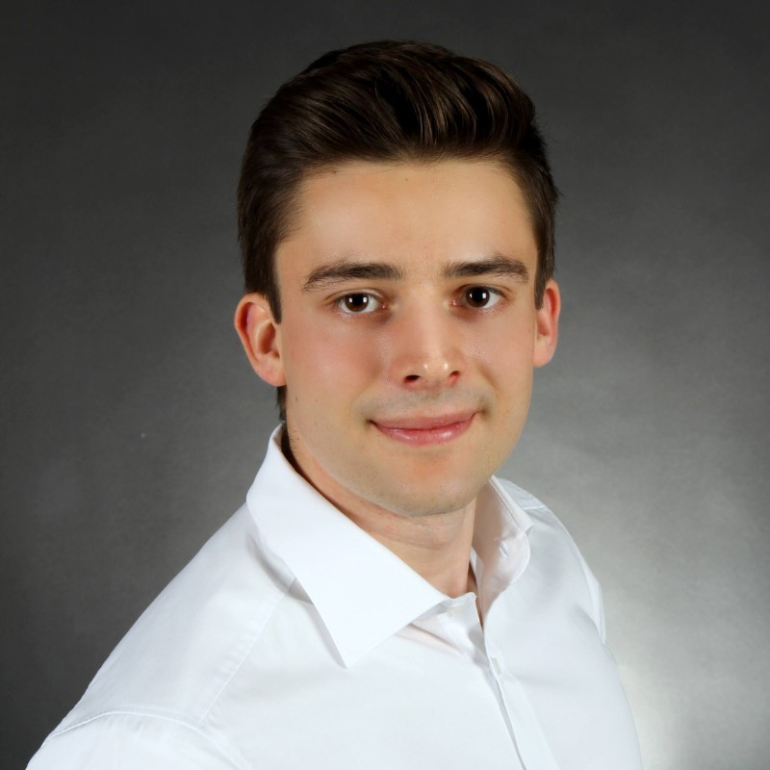

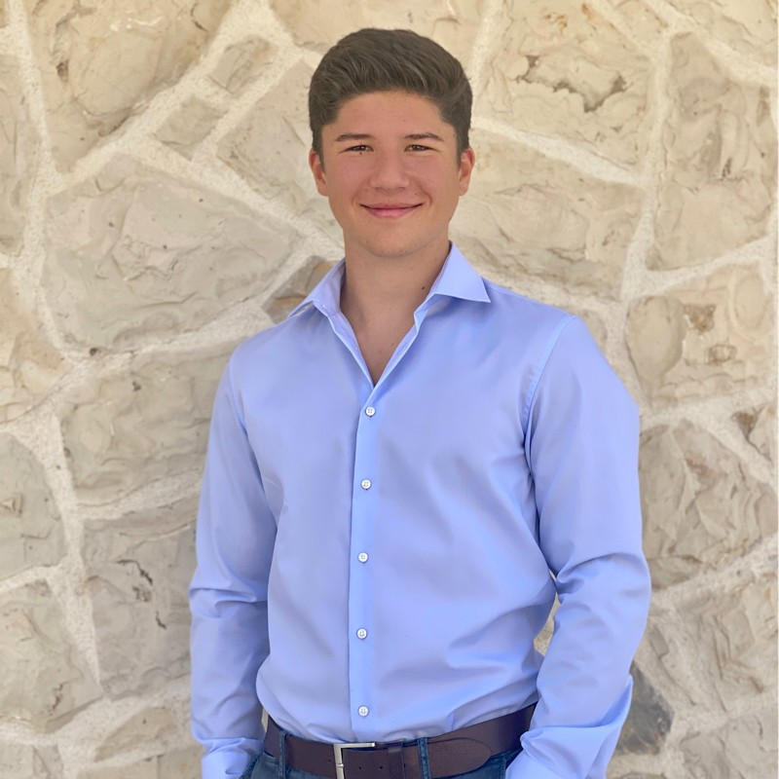
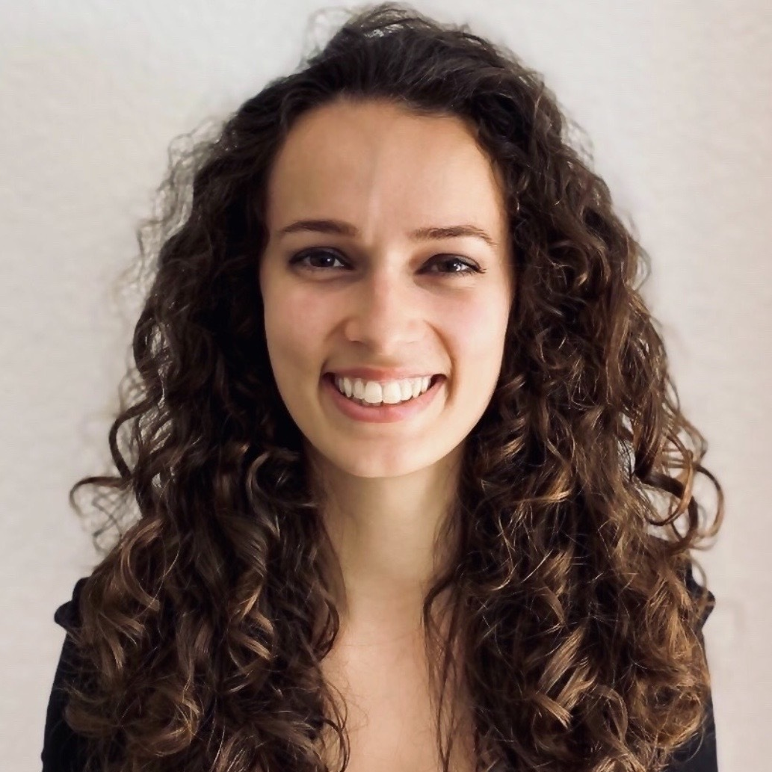

Team & Company
Ruben
Brabenec
Fatma
Ben Ayed
Marcel Kück
Isabella Patzke
Ali
Rabeh
Medicine @LMU
Helmholtz AI for Health
TVM Capital
Computer Science @TUM
Techlabs
Computer Science @TUM
Siemens
Medtech @TUM
Robotics, Cognition, Intelligence @TUM
Creating Insights through leading AI Software for data-driven deciscions to make healtcare accessible for anyone
Olorin [oˈloːrin] = Gandalf

Slide 15
Olorin AI
The Palantir for Healthcare
Leading solution for data-driven predictive decision making

Slide 16
Appendix
Acces which datastreams

Slide 17
Customer & Market
Starting with two fields of activity (Examples)
Staffing in Healthcare
Supply Chains in Healthcare
Customer
Hospitals (ICU, Surgery, Imaging, Emergency)
Outpatient (Imaging)
Service Providers
Wholesalers
Medtech & Pharma (with distribution channels)
Shortage & poor distribution of workforce
Undersupply
Lot of Human decision making
Shortage & poor distribution of med. products
Lot of Human decision making
Problem
Better distribution of patient-worker ratio
Lower costs
Increase of Revenues (increasing sales)
Better distribution & Insights
Lower costs
Increase of Revenues (increasing sales)
Outcome

